Slide 1



INSTITUTE: UIE (AIT-CSE)
CSS21: B.E. CSE (H) with specialization in Artificial Intelligence & Machine Learning
Advanced Machine Learning (20CSF-349)
Chapter 1.2: Logistic Regression
Lecture 7 & 8: Univariate Logistic Regression & Sigmoid Curve, Odds and Log Odds
By: Mr. Siddharth Kumar
DISCOVER . LEARN . EMPOWER

Slide 2
Advanced Machine Learning
Course Outcome
CO | Title
1 | Have a good understanding of the fundamental issues and challenges of machine learning: data, model selection, model complexity, etc.
2 | Appreciate the underlying mathematical relationships within and across Machine Learning algorithms and the paradigms of supervised and un-supervised learning
3 | Design and implement various machine learning algorithms in a range of real-world applications.
4 | Design and evaluate intelligent expert models for perception and prediction using machine learning algorithms
5 | Analyze and make use of machine learning algorithms-based applications using performance

Slide 3
What is Univariate Logistic Regression?
Univariate logistic regression has one independent variable, and multivariate logistic regression has more than one independent variables.
Univariate logistic regression is a supervised classification algorithm This is similar to linear regression, but is used when the dependent variable is categorical (despite its name regression). So, it targets the classification problems unlike linear regression for regression problems. Objective in classification is to map the observation (input) to its associated class or label.
Univariate logistic regression can be used for classification problems by using a threshold, however using least squares (the sum of the squares of the residuals) criteria is not more apt way for separating the classes for classification.
Univariate logistic regression predicts the probability of the outcome for a given input unlike linear function which predicts the outcome for a given input.

Slide 4
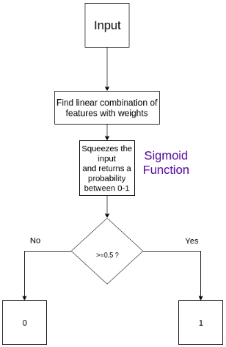
Flowchart of univariate logistic regression:

Slide 5
Algorithm for this is very similar to linear regression, only things we need to change is the representation of response(prediction) and the cost function
The response, while in linear regression we use a linear function of X ( θ^{T}X ), in univariate logistic regression we use sigmoid function of the linear function ( θ^{T}X ).
Logistic regression is a special type of generalised linear modelling where the outcome (dependent variable) is binary.
Univariate logistic regression also known as a Binomial/Binary/Univariable
If the dependent variable is a binary variable [True/False, 0/1] then it is known as an example of univariate logistic regression
For example, prediction of death or survival of patients, which can be coded as 0 and 1, can be predicted by metabolic markers.

Slide 6
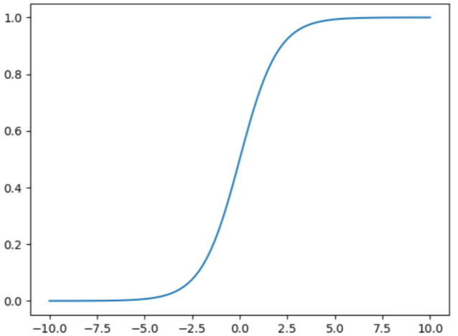
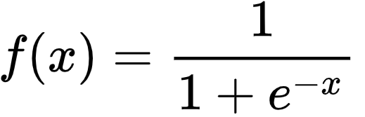
Sigmoid Curve
The logistic function in linear regression is a type of sigmoid, a class of functions with the same specific properties.
Sigmoid is a mathematical function that takes any real number and maps it to a probability between 1 and 0.
The formula of the sigmoid function is:
The sigmoid function forms an S shaped graph, which means as x approaches infinity, the probability becomes 1, and as x approaches negative infinity, the probability becomes 0. The model sets a threshold that decides what range of probability is mapped to which binary variable.
Sigmoid Curve

Slide 7
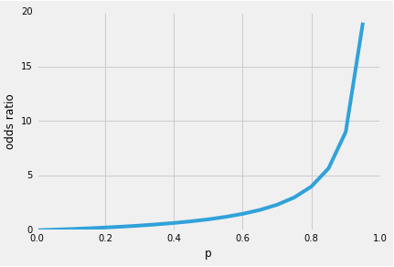

Why sigmoid function?
one of the nice properties of logistic regression is that the sigmoid function outputs the conditional probabilities of the prediction, the class probabilities. How does it work? Let’s start with the so-called “odds ratio” p/(1 - p), which describes the ratio between the probability that a certain, positive, event occurs and the probability that it doesn’t occur – where positive refers to the “event that we want to predict”, i.e., p(y=1|x).
Note that logistic regression a special kind of sigmoid function, the logistic sigmoid; other sigmoid functions exist, for example, the hyperbolic tangent.
So, the more likely it is that the positive event occurs, the larger the odds’ ratio. Now, if we take the natural log of this odds’ ratio, the log-odds or logit function, we get the following

Slide 8
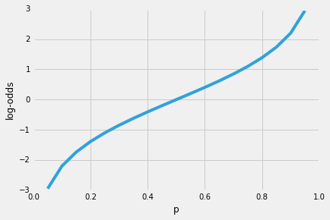
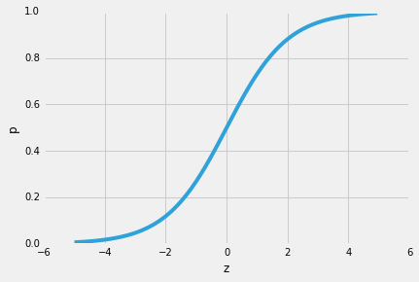

Next, let’s use this log transformation to model the relationship between our explanatory variables and the target variable:
Now, keep it mind that we are not trying to predict the right part of the equation. So, let’s take the inverse of this logit function, we get the logistic sigmoid:
Which returns the class probabilities *p(y=1|x)* from the inputs

Slide 9

Odds and Log Odds
Odds: Simply put, odds are the chances of success divided by the chances of failure. It is represented in the form of a ratio. As shown in equation:
where, p -> success odds
1-p -> failure odds
Log odds: Play an important role in logistic regression as it converts the LR model from probability based to a likelihood based model. Both probability and log odds have their own set of properties, however log odds makes interpreting the output easier. Thus, using log odds is slightly more advantageous over probability.
Probability, odds ratios and log odds are all the same thing, just expressed in different ways. It’s similar to the idea of scientific notation: the number 1,000 can be written as 1.0*103 or even 1*10*10*10. What works for one person, or one equation, might not work for another. In many cases, you can simply choose which format you want to use. Other times (for example, you’re publishing a paper or are using logistic regression), you might be forced to adopt a particular format.

Slide 10
Why Log Odds?
We sometimes choose to use log odds instead of more basic probability measures because they’re so easily updated with new data.
For instance, suppose you have a 5% chance that a thief will come in at your door on any given night. You have a watch dog, but he’s not terribly reliable; he’ll bark half the time if a thief comes, and just 1/4 of the time if the person walking by is an honest man. Now imagine you hear footsteps, and the dog barks.
Before your dog barked, the log odds of a thief were ln(.05/.95) = ln(1/19), or -2.9444. We call that your prior log odds for the thief. The likelihood ratio of a bark is just the probability of a bark with a thief (1/2) over the likelihood of a bark with no thief (1/4), and to find the log odds we take the log of that: ln((1/2)/(1/4)) = log(2) = 0.6931. Now the posterior log odds of the thief—the log odds that there is a thief, given you’ve just heard the dog bark—is -2.9444 + 0.6931, or -2.2513.

Slide 11
References
T1: Mitchell T.M., Machine Learning, McGraw Hill (1997).
T2: Andreas C. Miller, Sarah Guido, Introduction to Machine Learning with Python, O’REILLY (2001).
Notes:
Introduction to Cyber Security (simplilearn.com)

Slide 12

THANK YOU

